Slide 1

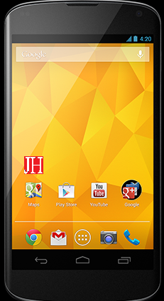
JUSTHARSH
Books
Dhawal Mehta and Harsh Mody present :
E008 Dhawal Mehta
E013 Harsh Mody

Slide 2
Why this app ?
This app came to us from our experiences as college students. We have made this app to make life easier for any college student.
It helps them to save and make money (without any jugaad ).

Slide 3
What’s new ?
Simple searching for books you need.
Easily find price quotations with books.
Buy books from fellow students at your own convenience.
Simple process for selling books without any hassle.
Keep check on status of your books.

Slide 4
Objectives
No more middleman ( so no more commission )
Simpler process for buying and selling of books.

Slide 5
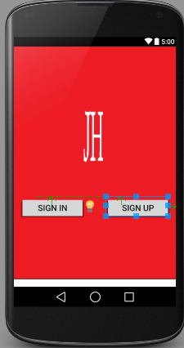
Sign in or Sign up
User either signs in
or signs up.
Signs in with student ID
and passkey
Signs up with StudentID
emailID and password.

Slide 6
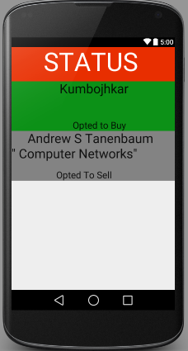
THE STATUS WINDOW
Helps you keep check
on all the mybooks
Mybooks consist of all
books which you want
to either sell or buy
It tells you whether a
seller or buyer has been
found.

Slide 7
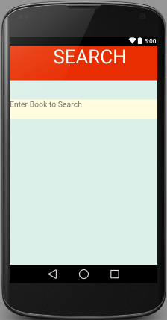
Book your Book !
User selects subject.
User searches for the book he requires.
App displays all available options.
User can now choose from the available sellers depending on book condition , price, edition , etc.
User can now request for the book and contact seller.

Slide 8
How to Sell ?
Select subject.
Select book.
Take a picture of your book.
App displays current price and recommended price.
User can now quote his price or just select recommended price.
App gives final summary for confirmation.
Book is now awaiting buyers(Status page).

Slide 9
More Selling
Book status can be checked on status page.
App notifies you once any buyer requests your book.
Buyer seller can now carry forward their transaction.

Slide 10
Features
Simple user interface
Easy to locate books
Efficient search of buyers and sellers
Sellers immediately notified once buyer requests book
Simple process to connect buyers and sellers

Slide 11
Safety Features
Users can decide whether or not to display phone numbers
Only email ID is essential
Sellers immediately notified once which buyer requests their book
Buyers and sellers can mutually decide on a safe location for conducting the transaction
Can search for books from the safety of their homes
Address of users not displayed

Slide 12
Future Scope
App can be extended to not only college textbooks
Add book recommendation service
Incorporate in app chat for users
Add book delivery service
Can also be linked to college services such as blackboard

Slide 13
Any recommendations ??
THANK YOU

